Slide 1
Routine SA processing with JD+
ESTP Training
05-07 October 2026

Slide 2
In-house developments
DB
Retrieve data/models from user environment
Create ts, spec
JD+ core libraries
Call JD+ routines
Retrieve results
Store data/models in user environment

Slide 3
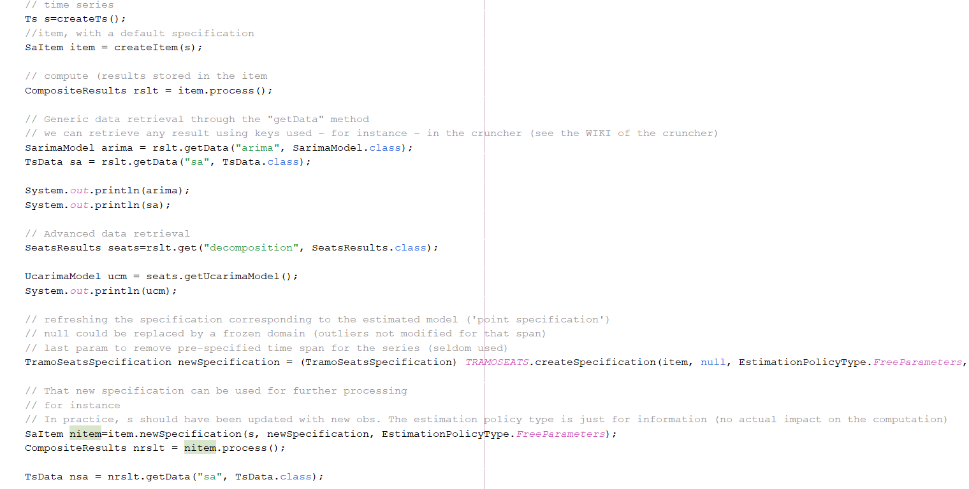
Java code

Slide 4
JD+ solution. Principles
Reference specification
Define the initial(or domain) specification
The estimation gives the point specification (=the result)
Refreshing the model « relaxes » some constraints; the new specification (=estimation specification) is always inside the domain specification
Tip: keep the initial specification as large as possible
Estimate
Point specification
Estimation specification
Refresh

Slide 5
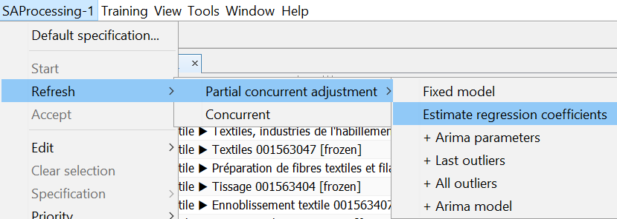
Updating policies
Policy | Re-estimation (cumulative)
Fixed model (partial concurrent) | Nothing
Regression coefficients (partial concurrent) | Regression coefficients
Parameters (partial concurrent) | Coefficients of the ARIMA model
Last outliers (partial concurrent) | Outliers of the last year
Outliers (partial concurrent) | All outliers
Arima (partial concurrent) | ARIMA orders
Concurrent | Log/level + calendar effects

Slide 6
Updating policies
Why?
  We want to minimize the revisions (at least in the short term).
  Origins of the revisions (decreasing importance)
    Structure of the model (outliers, ARIMA…)
    Parameters of the ARIMA model (Seats!)
    Coefficients of the regression variables
    News (forecasts ≠ actual data) →use forecasted seasonal factors or AO (fixed for revisions, free for new observations)

Slide 7
JD+ GUI (I)
Suitable for sets < 3000 series
Steps
  Initialization
    Define the default specification (or use an existing one)
    Modify some specifications (keep them « large »)
    Generate and export the results
    Save the processing

Slide 8
JD+ GUI (II)
  Next estimations
    Re-load the workspace
    Refresh the processing (for instance)
      For normal re-estimation, refresh only the parameters
      Refresh the model once each year (or each two years)
      Inspect the results and modify them if need be (will modify some « domain specifications »
    Exports the results and save the workspace.

Slide 9
JWSACruncher (I)
Suitable for any number of series (split the workspace is several SAProcessing) if need be
Steps
  Initialization:
    generate the input file (=workspace), using the GUI (don’t process the multi-processing) or using in-house programs

Slide 10
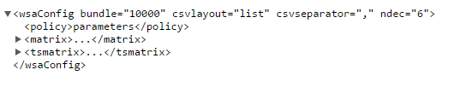
JWSACruncher (II)
    Define the setting file for the cruncher
      Output, format, paths…
    Call the command line
  Next estimations
    Modify the setting file (if need be)
    Re-call the command line

Slide 11
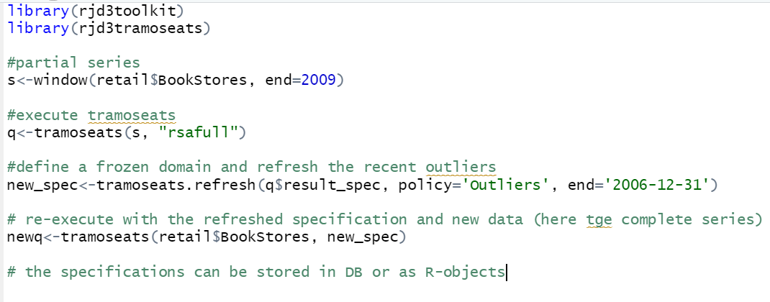
rjd3

Slide 12
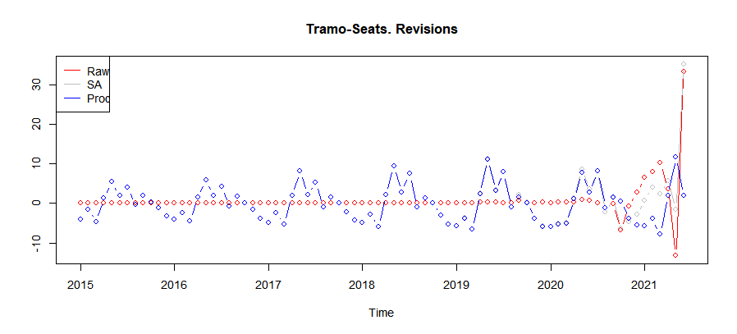
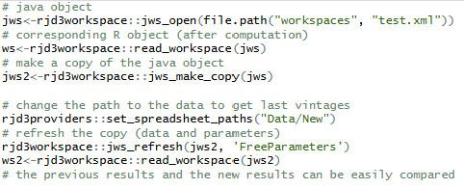
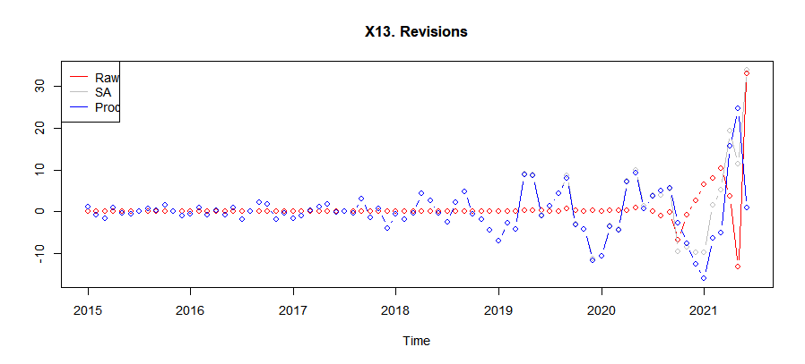
rjd3workspace
Read/write operations on workspaces
Refreshing policies
…

